Slide 1
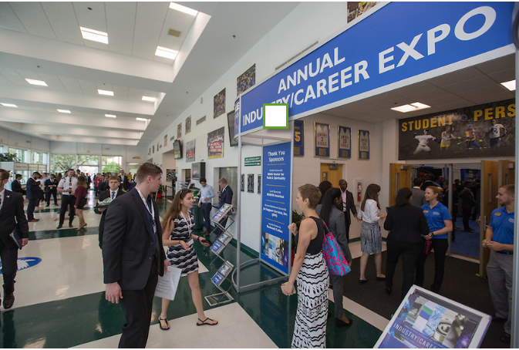
Worldwide Career Services
LAX Airport Police Internship
JA
Going Places
http://worldwide.erau.edu/career-services/index.html

Slide 2
Welcome to Worldwide Career Services
Are you a future student, current ERAU student, or alumni?
We are committed to engaging with students and alumni to provide
✶ quality, comprehensive career-related services
✶ resources to maximize career potential
to empower you to excel in today’s highly competitive global employment market!

Slide 3
Create Your Career Strategy Checklist … Early!
Contact us today to:
Discuss your career strategy
Create a Handshake profile and submit your resume for review and
approval
Schedule your 1-on-1 appointment with Career Services for an
overview of ERAU networking resources
Explore co-op/internship options
Explore career opportunities (including international jobs)
Contact WW Career Services @
wwcarser@erau.edu or 386.226.6092 / 386.226.3737

Slide 4
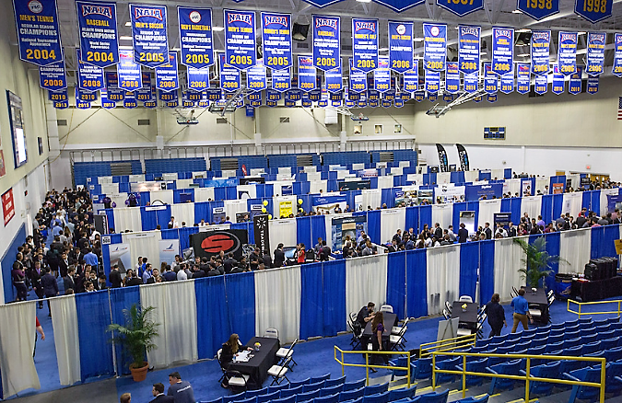
Career Resources
You will have access to the following:
Handshake the gateway to ERAU career resources
Co-op/Internship Opportunities bridge academic and career interests to provide “real world” experience
Networking Resources provide access to potential employers (LinkedIn)
Career Preparation includes resume review, job search techniques and interviewing tips
Additional Resources for unique groups

Slide 5
Career Resources
Provide a starting point for any career search and development
Handshake: Primary career management platform. This site includes all types of job postings and a Resources section with sample resumes and cover letter templates.
CareerShift: Search engine for US jobs and companies. This site provides you with the ability to create your own personal marketing campaign
GoinGlobal: Search engine for international jobs and companies. This site provides you with insider tips for finding employment abroad.
CareerSpots: Web site provides you with 2-minute reminders on how to prepare for job searches, interviews, accepting job offers, etc.

Slide 6
Co-op/Internship Opportunities
Provide professional experience in your degree field
Co-ops and internships are academic/work experience opportunities for undergraduate and graduate students
Co-ops and internships provide students with valuable experience in their degree program prior to graduation
Co-ops and internships reduces the transition time to full-time employment
Co-op and internships build and strengthen key relationships between ERAU, industry, government and alumni

Slide 7
Co-op/Internship Requirements
To be eligible undergraduate applicants must be:
Active full-time student in degree seeking program
Have cumulative 2.5+ GPA
Have completed 30 overall credits hours (12 credits must be from ERAU)
To be eligible graduate applicants must be:
✓ Active full-time student in degree seeking program
Have cumulative 3.0+ GPA
Have completed 9 credit hours prior to start of internship (6 ERAU credits to apply to the program)

Slide 8
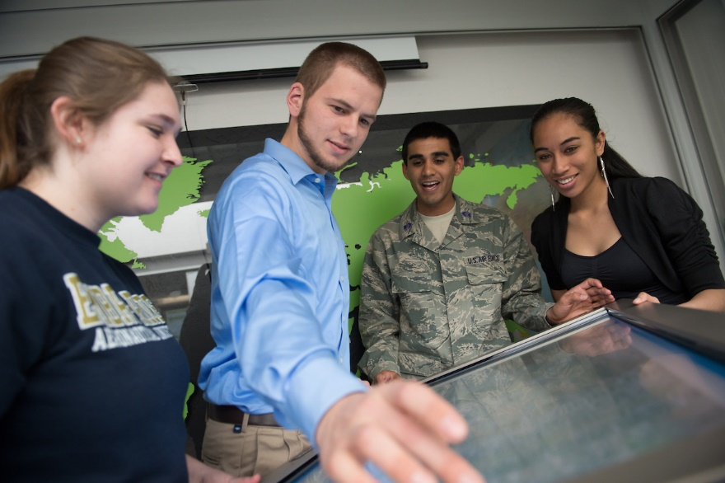
Co-op/Internships
Provide academic credit based on the following:
Undergraduates must work 300 hours = 3 credit hours
Graduates must work 600 hours = 3 credits
Tuition = cost of 1 credit hour per 3 credits earned

Slide 9
Networking Resources
Visit both the Worldwide Career Services and Handshake sites for 24/7 access to networking resources
WW Career Services LinkedIn: Posts weekly career opportunities along with career related articles
Alumni LinkedIn: Identifies companies by geographical area where ERAU alumni are currently employed
Special Resources: Web sites developed just for veterans, students with disabilities, federal employment and international job seekers
Professional Organizations
https://worldwide.erau.edu/career-services/
https://www.joinhandshake.com/

Slide 10
Career Preparation
Start early by:
Submitting your resume for review
Reviewing and updating your Handshake profile and personal references
Setting up your 1-on-1 phone interview with career services
Joining professional organizations, honor societies, or community groups
Researching and targeting employers

Slide 11
Career Events
Worldwide Campus proudly sponsors four Industry/Career Expo events to provide students and alumni access to industry-leading employers in Fort Walton Beach, San Diego, Seattle, and Dallas, as well as Daytona Beach and Prescott.

Slide 12
Worldwide Career Services
Need Assistance?
Please contact the
Worldwide Career Services Office:
wwcarser@erau.edu
386-226-6092
386-226-3737
Notes:
Titles are 60 font, Gridlines on to see margin spacing and body of text design.

